Slide 1



The Most Beautiful Equation in Mathematics
2025 Green Path Summer School

Slide 2
Introductions
Instructor: Prof. Sotirios (Sotos) Damouras
Teaching Probability, Statistics, and Quantitative Finance
Substituting for Prof. Parker Glynn-Adey
Teaching Assistants
Simon Liu
Yuyang Wang
Alex Dennis
Li Zhang

Slide 3

Materials
Presentation available at my webpage:
https://damouras.github.io/teaching/
Extensive course material available at Parker’s webpage
https://pgadey.ca/notes/eulers-identity/
Including
Lecture Notes
Worksheet w/ Solutions

Slide 4
Agenda
“Prove” Euler’s Formula:
Called the most beautiful equation in Mathematics
Combines fundamental mathematical objects
Exponential function
Trigonometric functions
Complex numbers

Slide 5
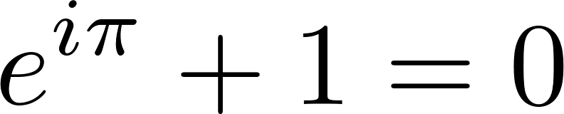
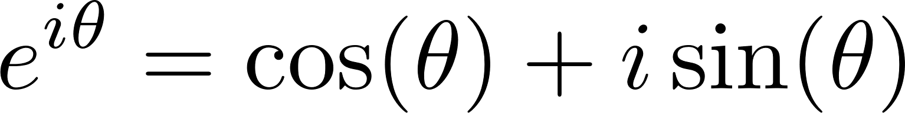
Euler’s Identity
Euler’s Identity:
Special case of Euler’s formula:
Which value of θ produces it?
Involves all important mathematical numbers
0
1
π
i
e

Slide 6
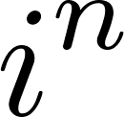
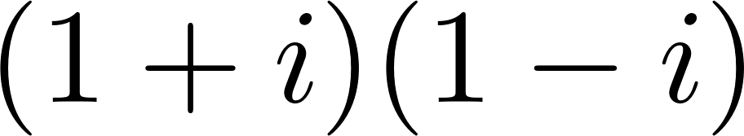
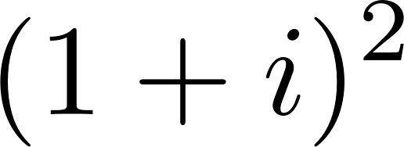
Calculating Complex Numbers
Calculate the following expressions:

Slide 7
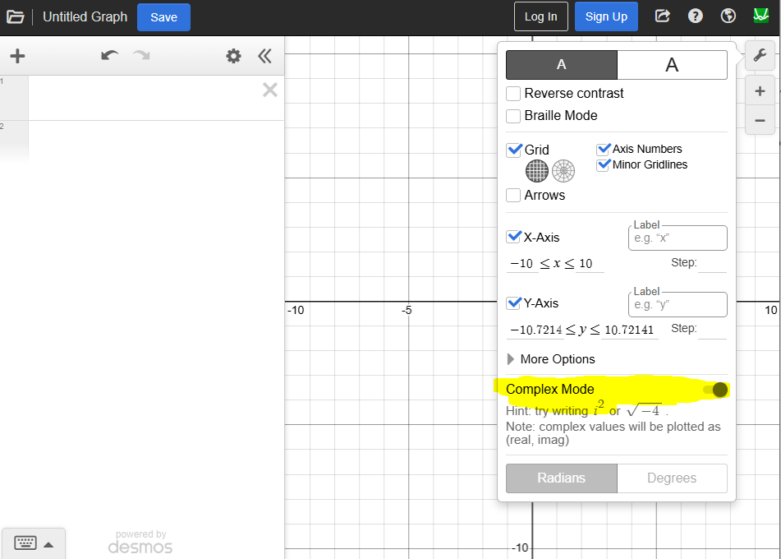
Drawing Complex Numbers
Plot the complex numbers on the complex plane using www.desmos.com/calculator
What do you observe?
Numbers are part of Logarithmic Spiral
Desmos

Slide 8
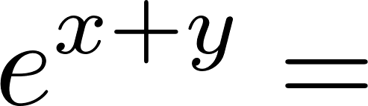
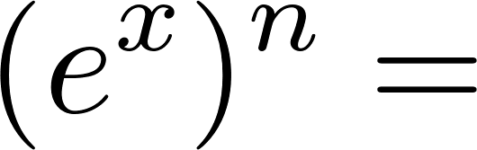
Exponentials
Fill in the following exponential function properties:
De Moivre’s formula:
Proof using Euler’s formula

Slide 9
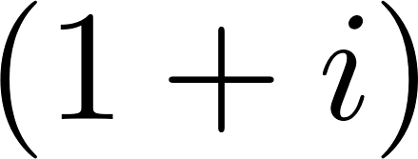
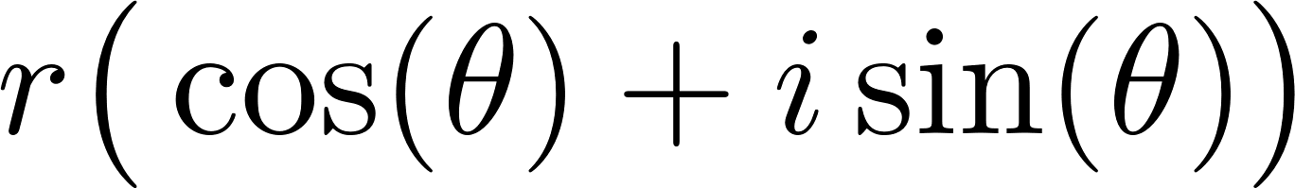
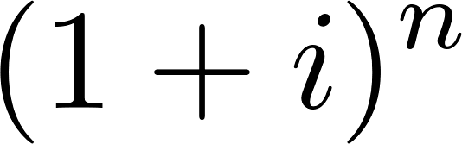
Application
Express in the form
Apply De Moivre’s formula on

Slide 10
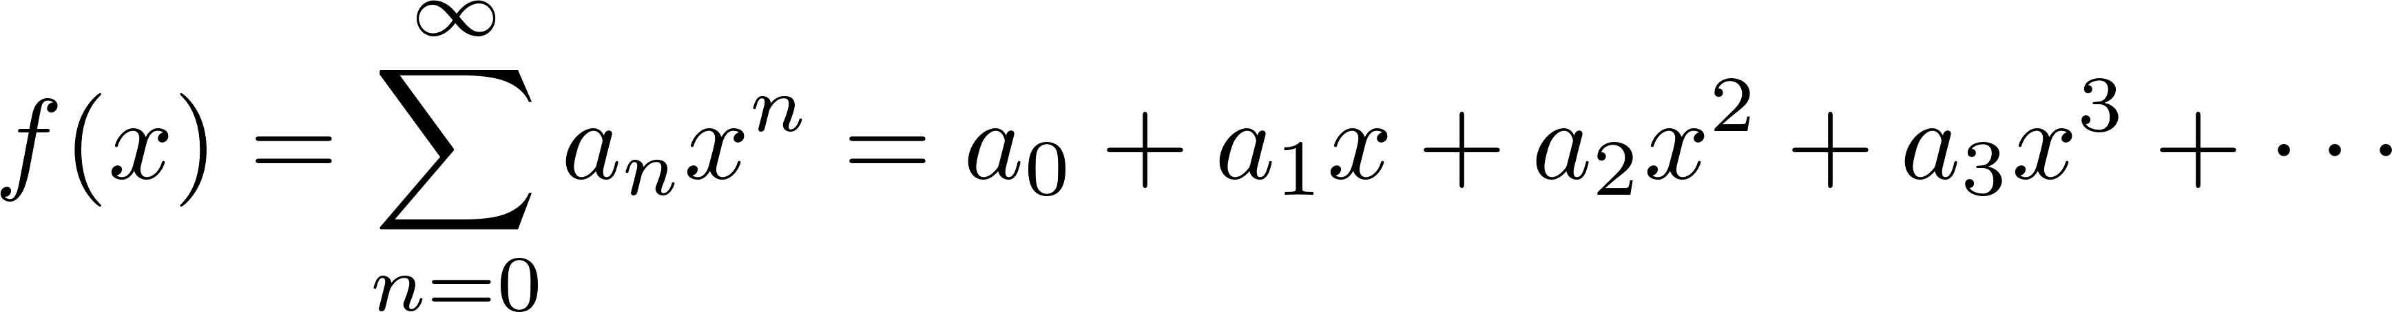
Power Series
Many functions can be equivalently expressed as Power Series
Coefficients a_{n} determine function (like its “DNA”)
Such functions are called entire and include the exponential and trigonometric functions

Slide 11
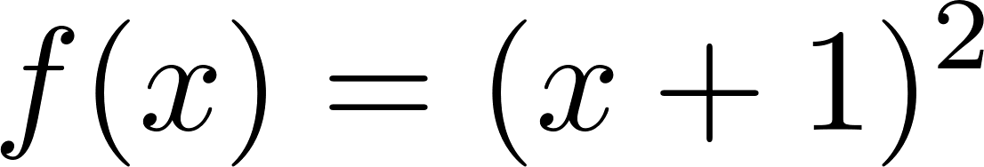
Example
Express polynomial function as power series (i.e., find its coefficients)

Slide 12
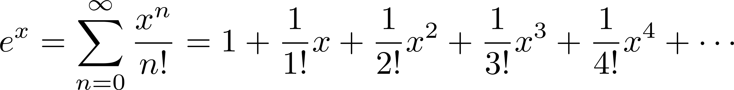
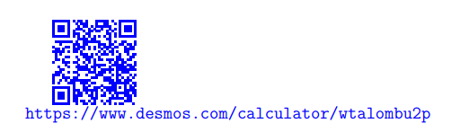
Exponential Function
The exponential function can be expressed as
where n! is factorial

Slide 13
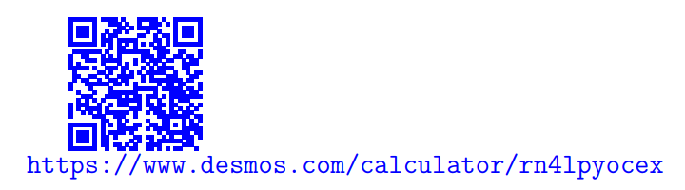
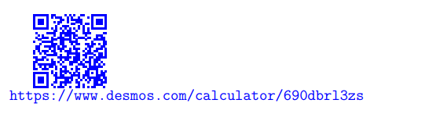
Sine Function
The cosine function can be expressed as
The sine function can be expressed as

Slide 14
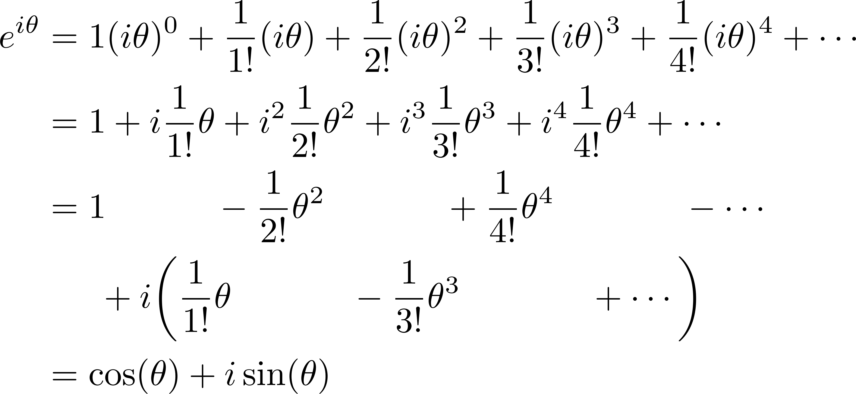
Proof of Euler’s Formula
Plug x=iθ in power series for exponential:

Slide 15
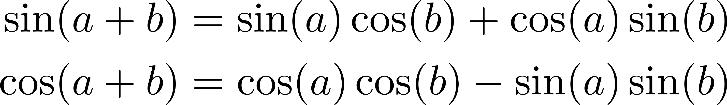
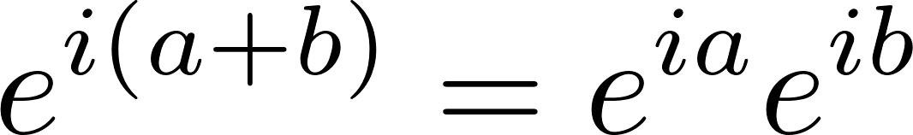
Application
Let’s prove the trigonometric angle sum identities
Hint: Use the property , expand with Euler’s formula, and equate terms

Slide 16

Thank You!
How did we do?
Please fill in this → feedback form
https://forms.gle/PZhTiUY2czKoM3sGA

